Slide 3
GBA PROGRAMS & EVENTS
Signature Events
Mt Holly Community Awards (May)
Golf Classic (October)
Salute to Business (May)
Candidate Forums (Fall)
Economic Forecast (November)
Annual Celebration (December)
Annual Events
Professional Women’s Association
Women Who Rock (October)
Safety Awards (June)
Other
Business After Hours
Leadership Gaston (March/Sept)
Teacher Appreciation(August)

Slide 4
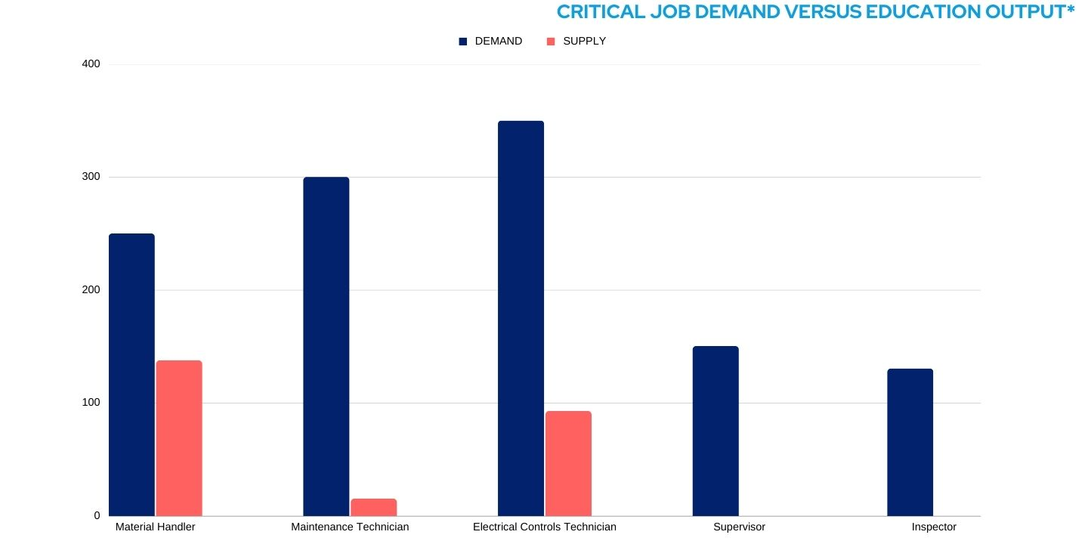
Addressing Talent Needs in Gaston Region
Current State
Economic growth facing dwindling labor supply
90% gap between job demand & education network output
Employers struggling with turnover, accelerated retirements, upskilling workers
Barriers restrict learner access to education pathways
New way of thinking, rapid innovation, aggressive action needed to close gap
Opportunities
Gaston partners & statewide allies embracing innovation to address new landscape head- on
Talent Partnership innovating to dramatically increase quality & quantity of talent
Protects NC #1 in business ranking

Slide 5
initiatives
Advocacy & Economic Development
Support for business-friendly policies
Enhancement of Gaston’s:
Economic diversification
Overall reputation
Regional Position
Business Engagement
Innovative, impactful and inclusive approaches, programs, and events to address critical needs of the business community
Talent Development & Retention
- Address vital workforce matters through talent pipeline programs to sustain Gaston’s long-term economic vitality

Slide 6
guiding statements
Purpose
We exist to drive business success and economic growth throughout Gaston County.
Vision
We envision Gaston County leading the region in prosperity and opportunity for all.
Mission
We strategically generate bold advocacy,
business, and talent outcomes.

Slide 7
GBA: Background
Machine Operators | Forklift Operators/Material Handlers | Maintenance Technicians | QA Technicians and More

